Slide 1

WEB SCRAPING TO GAIN COMPANY INSIGHTS
08/07/2024

Slide 2
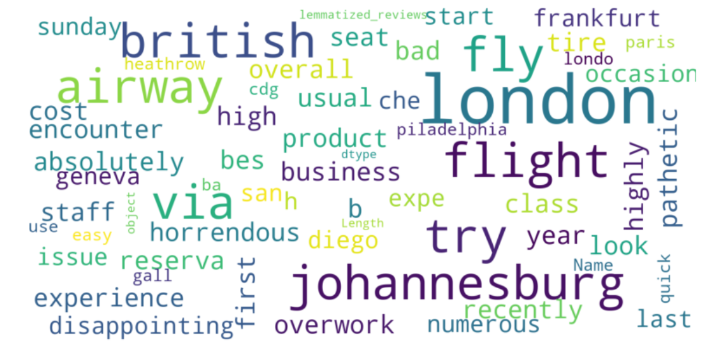
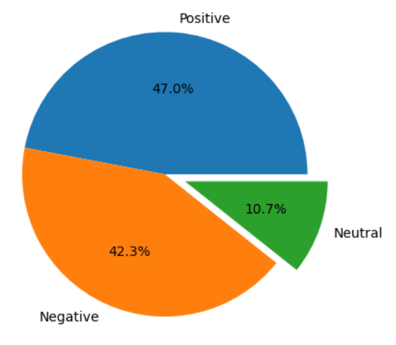
INSIGHTS FROM CUSTOMER REVIEWS
From cleaning 1000 reviews given by the customers, we obtained
Positive Reviews - 470
Negative Reviews - 423
Neutral Reviews - 107

